Slide 1

First Experiments at FAB10: Towards Time-resolved Molecular Frame Photoelectron Angular Distributions
Fabian HOLZMEIER
Institut des Sciences Moléculaires d’Orsay
ATTOLab user meeting 2017 8 November 2017

Slide 2




Collaborators
Users’ meeting 2017
Lawrence Berkeley National Laboratory
Robert Lucchese
Institut des Sciences Moléculaires d’Orsay
Danielle Dowek
Fabian Holzmeier (Labex PALM)
Jennifer Joseph (PhD, Aspire ITN/EFN)
Jean-Christophe Houver
OPT2X
Carlo Spezzani
ATTOLab – CEA/Lidyl
Thierry Ruchon
David Bresteau
Attophysics group + SLIC
Synchrotron SOLEIL
John Bozek
PLEIADES beamline

Slide 3
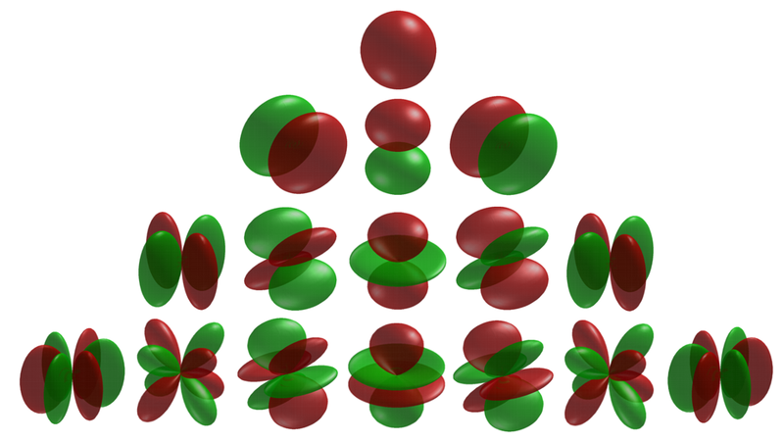
Photoelectron Angular Distributions (PADs)
Users’ meeting 2017
photoionization: A + hν (XUV or x-ray) → A⁺ + e⁻
spatial distribution of the ejected electrons = PADs
  describe photoionization dynamics completely
  depend on light polarization
  partial wave expansion
What about molecules?
  enhanced scattering effects
  random orientation with respect to polarization
s
p
d
f
Notes:
Complete description of a photoionization reaction >> PADs
PADs can be expanded as partial waves, strict selection rules for atoms
Molecules: more complicated >> enhanced scattering, no strict selection rules, random orientation
>> need to define a molecular frame

Slide 4
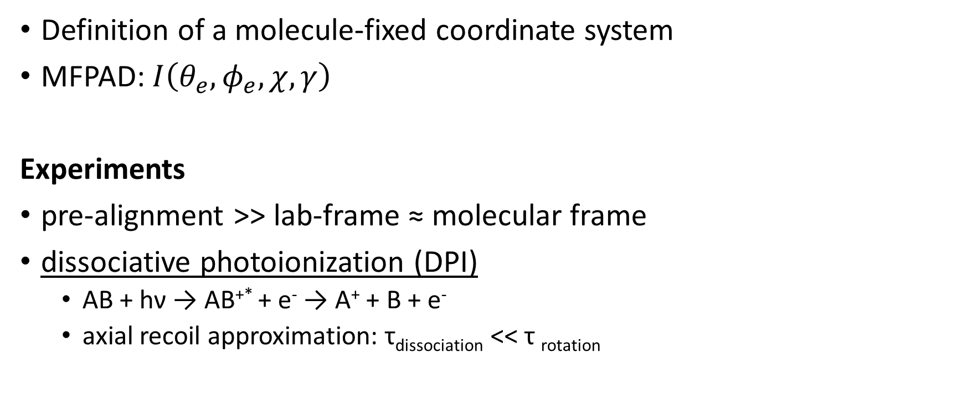
Molecular Frame PADs (MFPADs)
Users’ meeting 2017
Definition of a molecule-fixed coordinate system
MFPAD: $I\left(θ_{e}, φ_{e}, χ, γ\right)$
Experiments
pre-alignment >> lab-frame ≈ molecular frame
dissociative photoionization (DPI)
  AB + hν → AB^{+*} + e⁻ → A⁺ + B + e⁻
  axial recoil approximation: τ_{dissociation} << τ _{rotation}
H. Stapelfeldt and co-workers, Nature Physics 6, 428-432 (2010).
M. Lebech, J. C. Houver, D. Dowek, Rev. Sci. Instrum. 73, 1866 (2002).
Notes:
Example diatomic molecule: molecular axis
Alignment (cannot be achieved to 100%) vs. DPI
Axial recoil approximation
How can such an experiment be performed?
($χ, γ$ >> polar and azimuthal angle of molecule for elliptically polarized light!)

Slide 5
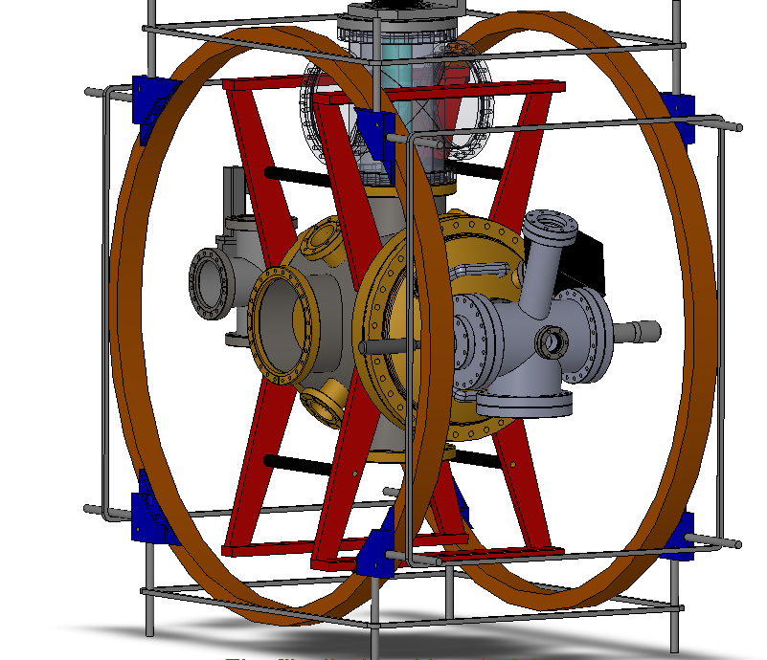
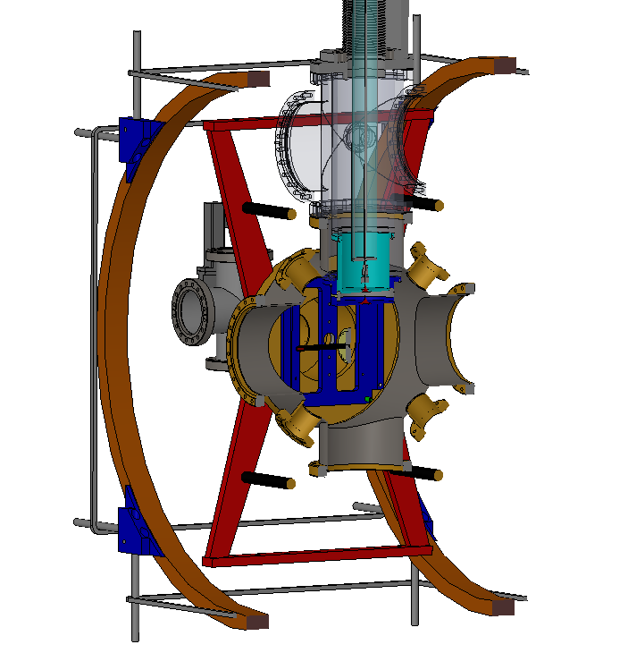
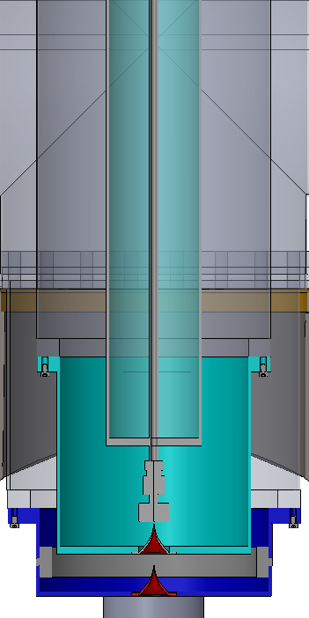

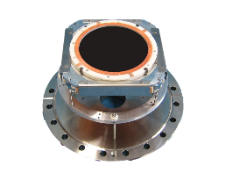
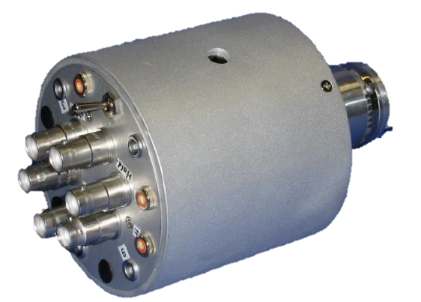
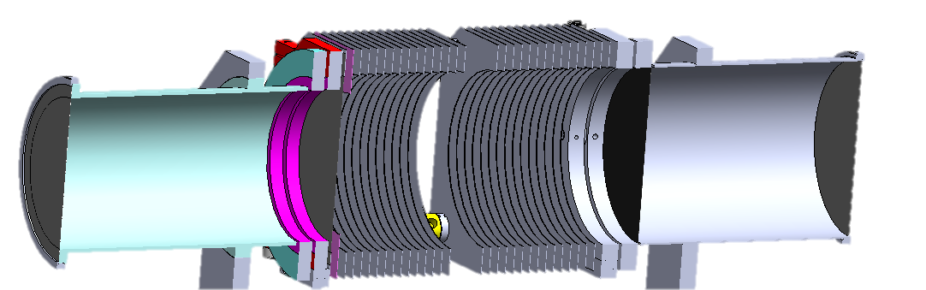


Vector Correlation with CIEL
Users’ meeting 2017
Coïncidences entre Ions et Electrons Localisés
  supersonic molecular beam
  electrostatic extraction field
  time- and position sensitive detectors (Roentdek)
  electrostatic ion focusing
  magnetic field for helical electron trajectory
M. Gisselbrecht et al., Rev. Sci. Instrum. 76, 013105 (2005).
M. Lebech et al., Rev. Sci. Instrum. 73, 1866 (2002).

Slide 6
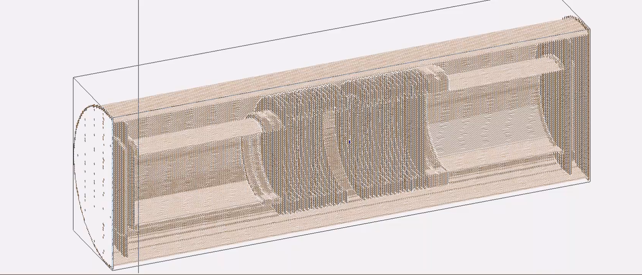
Vector Correlation with CIEL
Users’ meeting 2017
SIMION simulation 15 V/cm
blue: 10 eV electron
red: 1 eV O⁺ ion
Notes:
Simulation to show the helical trajectory of the electron

Slide 7
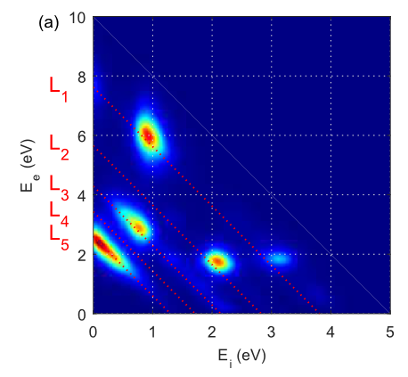

Vector Correlation with CIEL
Users’ meeting 2017
Observables
times-of-flight (TOF) and positions for ions and electrons
in coincidence!
KECD: $O_{2}+hν→O_{2}^{+}+e^{−}→O+O^{+}+e^{−}$
26.35 eV
x, y, TOF
B ²Σ_{g}⁻
x, y, TOF
v_{x}, v_{y}, v_{z}
E_{kin}
3²Π_{u}
E_{kin}
v_{x}, v_{y}, v_{z}
c ⁴Σ_{u}⁻
For every event:
χ,γ
lab frame → molecular frame
θ_{e}, ϕ_{e}
χ_{e},γ_{e}
Histogrammed for selected process
Notes:
Observables = TOF (also electrons) and positions >> velocity components >> kinetic energy >> electron ion coincidence >> KECD
O2: several pronounced processes are identified @26.35 eV = different ionic states dissociating to different dissociation limits
For every complete event, the ion emission angle defines the MF >> MFPAD=spatial histogram for a selected process in the KECD

Slide 8
Example: DPI of O₂ (Synchrotron)
Users’ meeting 2017
Time-of-flight
mass spectrum
O⁺
O₂⁺
H₂O⁺
Processing
OH⁺
Observables
Notes:
Illustration of the previous description on an example performed at SOLEIL (Désirs and Pléiades)
Selection of TOF region; x,y,TOF >> vx,vy,vz >> KECD

Slide 9

Example: DPI of O₂ (Synchrotron)
Users’ meeting 2017
Kinetic Energy Correlation Diagram (KECD)
Process selection
$$O_{2}\left(X^{3}Σ_{g}^{−}\right)+hν →$$
$$→O_{2}^{+}\left(B^{2}Σ_{g}^{−}\right)+e^{−}→O^{+}\left(4S\right)+O\left(3P\right)+e^{−}$$
$$→O_{2}^{+}\left(c^{4}Σ_{u}^{−}\right)+e^{−}→O^{+}\left(4S\right)+O\left(1D\right)+e^{−}$$
$→O^{+}\left(4S\right)+O\left(3P\right)+e^{−}$
$$→O_{2}^{+}\left(3^{2}Π_{u}\right)+e^{−}→O^{+}\left(2D\right)+O\left(3P\right)+e^{−}$$
T. Okino et al., J. Phys. B: At. Mol. Opt. Phys. 47, 124007 (2014).
Notes:
As discussed before, KECD shows different processes
Theory and previous experiments (e.g. PEPICO) help assigning these processes
In the following: selection of 3 2PI state to L3 limit
Selection of all events with a certain orientation of the molecular axis >> MFPAD for this orientation

Slide 10
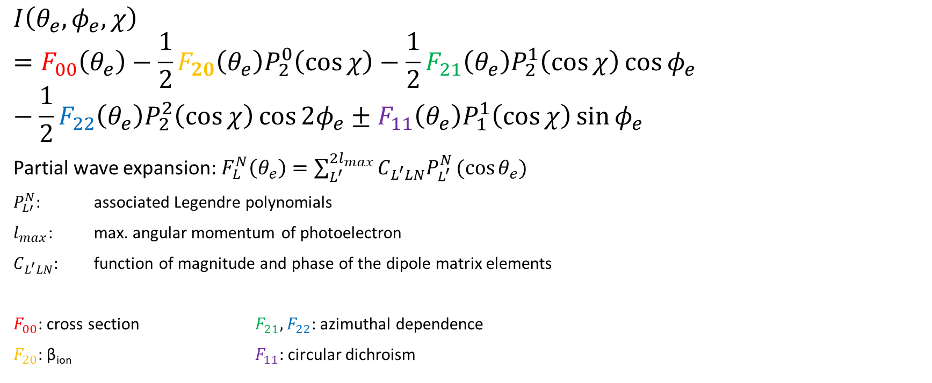
MFPAD with Circular Polarization
Users’ meeting 2017
$$I\left(θ_{e},φ_{e},χ\right)=F_{00}\left(θ_{e}\right)−\frac{1}{2}F_{20}\left(θ_{e}\right)P_{2}^{0}\left(\cos{χ}\right)−\frac{1}{2}F_{21}\left(θ_{e}\right)P_{2}^{1}\left(\cos{χ}\right)\cos{φ_{e}}−\frac{1}{2}F_{22}\left(θ_{e}\right)P_{2}^{2}\left(\cos{χ}\right)\cos{2φ_{e}}±F_{11}\left(θ_{e}\right)P_{1}^{1}\left(\cos{χ}\right)\sin{φ_{e}}$$
Partial wave expansion: $F_{L}^{N}\left(θ_{e}\right)=\sum_{L^{′}}^{2l_{max}}{C_{L^{′}LN}P_{L^{′}}^{N}(cos{θ_{e}})}$
$P_{L′}^{N}$: associated Legendre polynomials
$l_{max}$: max. angular momentum of photoelectron
$C_{L^{′}LN}$: function of magnitude and phase of the dipole matrix elements
$F_{00}$: cross section $F_{21}, F_{22}$: azimuthal dependence
$F_{20}$: β_{ion} $F_{11}$: circular dichroism
The MFPAD for any arbitrary polarization can be extracted!
In addition: molecular polarimetry
determination of Stokes parameters (s₁, s₂, s₃)
R. R. Lucchese et al., Phys. Rev. A 65, 020702 (2002).
Notes:
BUT: our group (and RL) have developed a more powerful analysis method
MFPAD for all orientations can be broken down in a Fourier analysis depending on five one-dimensional Fij functions only (for the most general case, CP)
Fij are partial wave expansions and can be related to certain characteristics…
We use ALL events to determine the Fij functions and can then substitute \chi with a certain angle (e.g. 0° for par, 90° for per) to determine the MFPAD for that orientation
>> very efficient method for coincidence experiments with low statistics

Slide 11
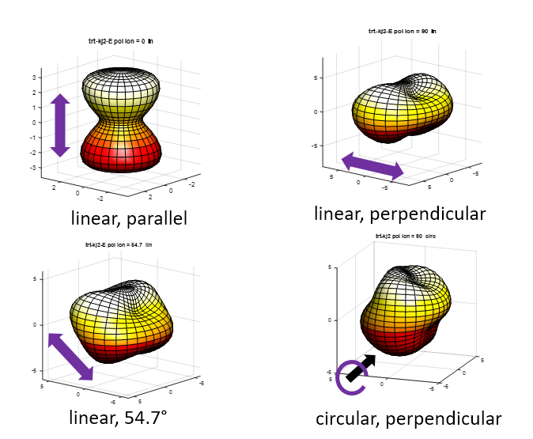


Example: DPI of O₂ (Synchrotron)
Users’ meeting 2017
$$O_{2}(3Σ_{g}^{−})+hν→O_{2}^{+}\left(3^{2}Π_{u}\right)+e^{−}→O^{+}\left(2D\right)+O\left(3P\right)+e^{−}$$
$$dπ_{g}$$
$$dδ_{g}, dσ_{g}, sσ_{g}$$
O⁺
O
circular
Notes:
F21, F22 > significant azimuthal dependence
Parallel and perpendicular transition dominant partial waves
Magic angle = superposition of par and per >> relative phases of partial waves for par and per

Slide 12
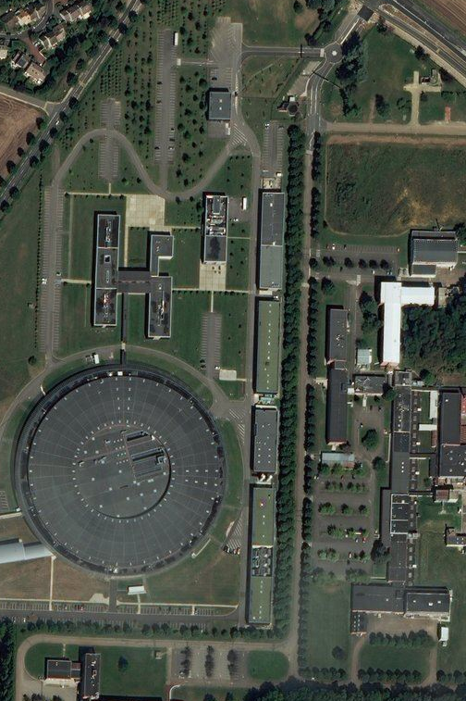
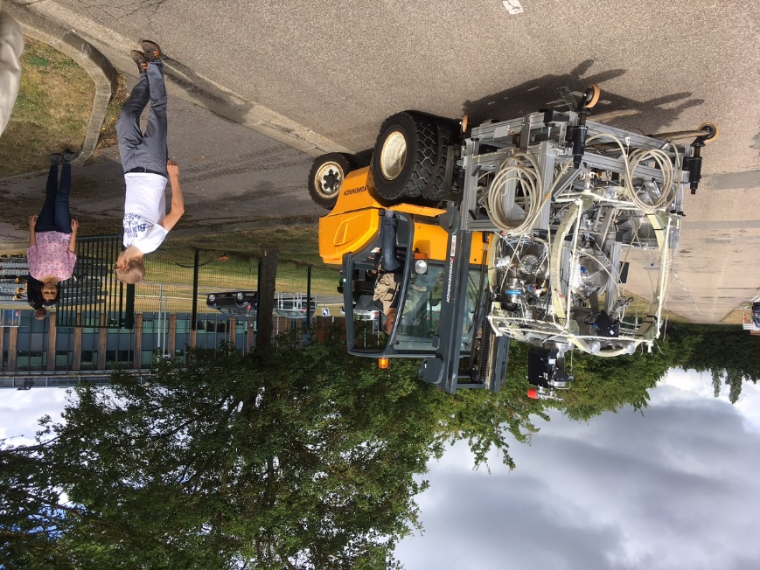

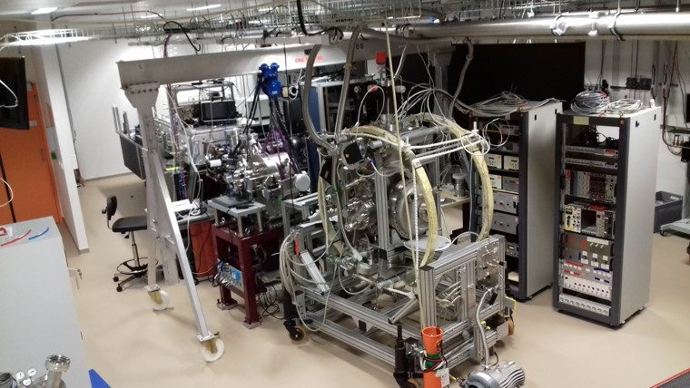
ATTOLab
Users’ meeting 2017
FAB10: 10 kHz rep. Rate
800 nm, 15 fs, 2 mJ, CEP, 20 W
Versatile monochromator with 3 modes:
Narrow-band, broadband, very broadband
Notes:
synchrotron: extremely high spectral resolution, but ps pulses
Time-resolved experiments with APT: Attolab
CIEL was successfully installed

Slide 13
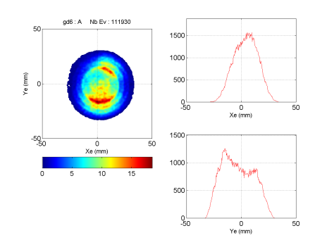
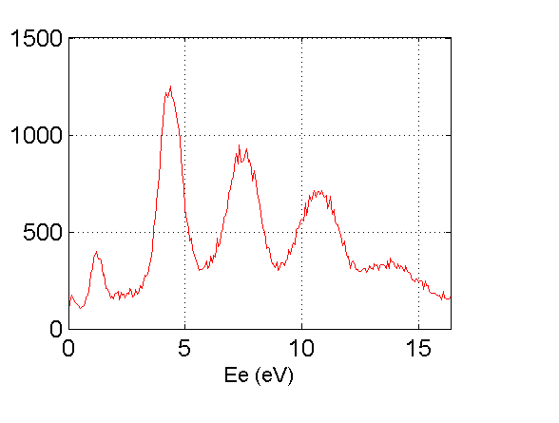
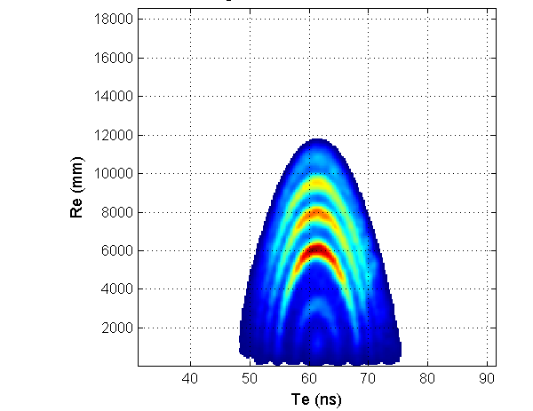
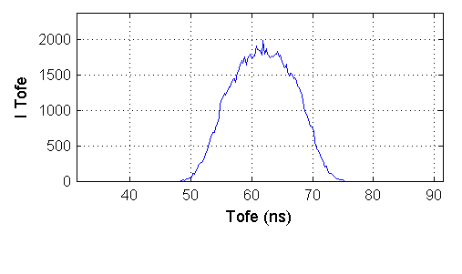
ATTOLab: First Tests with Harmonics
Users’ meeting 2017
Argon (IE=15.76 eV)
H13
H15
H17
H11
H19
Notes:
First tests on Ar
Image: contribution of several harmonics can be seen
Even more visible in « wiggle » spectrum Re-Te and KECD
PES = harmonics spectrum (if normalized on cross-section of Ar)
we want to measure time-resolved MFPADs

Slide 14
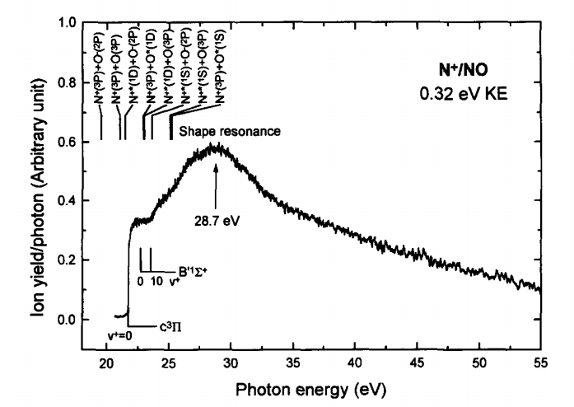
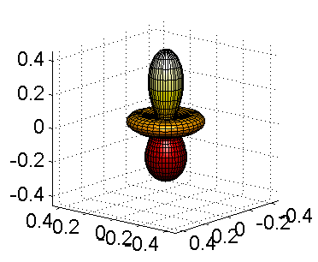
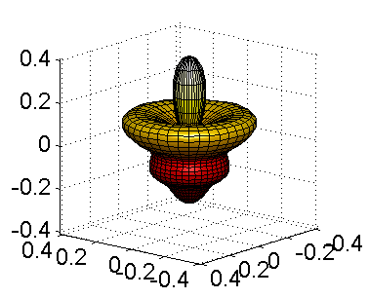
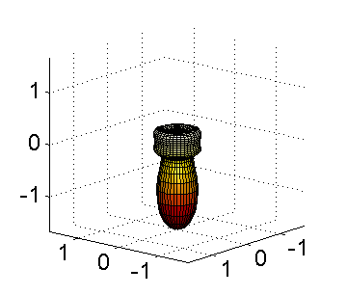
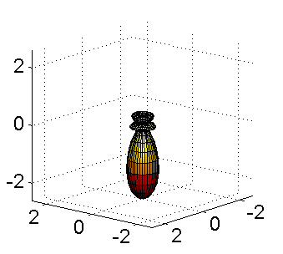
DPI of NO to N⁺
Users’ meeting 2017
H19
H17
H21
PLFA 2014
H15
H23
H15
H17
H23
H25
H21
H19
H17
Y. Lu, W. C. Stolte, J. A. R. Samson, J. Electron Spectrosc. Rel. Phenom. 1997, 109-120 (1997).
H15
H19
H21
$$NO+hν →NO^{+}\left(c^{3}Π\right)+e^{−} →N^{+}\left(3P\right)+O\left(3P\right)+e^{−}$$
l=2,m=0
l=2,m=1
K. Veyrinas et al., Faraday Discuss. 194, 161 (2016).
Notes:
Interesting molecule: NO
Experiment at PLFA shows: DPI dominated by one process
With the APT, we scan the well-known shape resonance at 28.7 eV
MFPADs show strong dependence on harmonic order (par)
Module and phase of dipole matrix elements can be extracted, parallel transition: l=2, m=0
Only spectrally resolved >> time-resolved MFPADs needs e.g. RABITT-like experiment XUV+IR

Slide 15
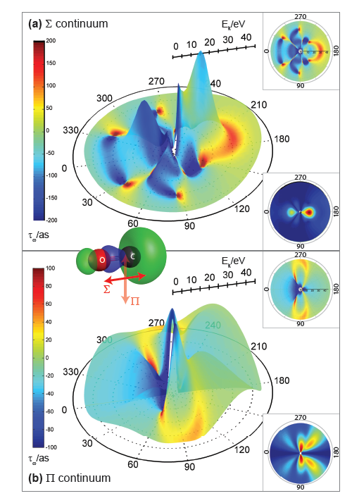
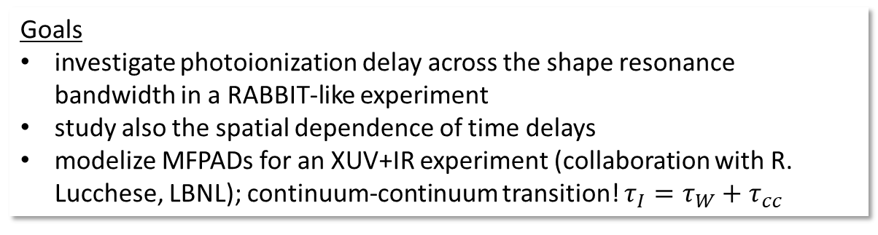
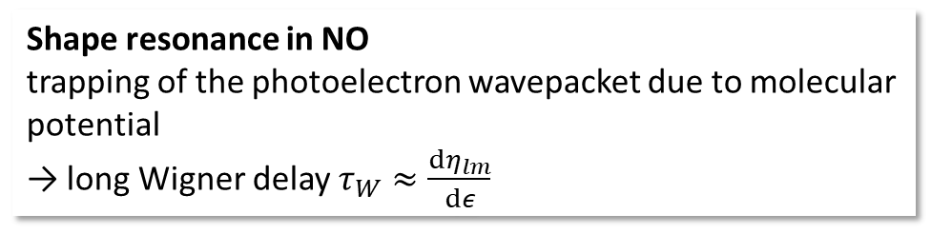
Time Delay in Molecular Photoionization
Users’ meeting 2017
Shape resonance in NO
trapping of the photoelectron wavepacket due to molecular potential
→ long Wigner delay $τ_{W}≈\frac{dη_{lm}}{dε}$
Goals
investigate photoionization delay across the shape resonance bandwidth in a RABBIT-like experiment
study also the spatial dependence of time delays
modelize MFPADs for an XUV+IR experiment (collaboration with R. Lucchese, LBNL); continuum-continuum transition! $τ_{I}=τ_{W}+τ_{cc}$
Hockett et al, J. Phys. B At. Mol. Opt. Phys. 49, 095602 (2016).
Notes:
Why is a time-resolved experiment interesting?
Trapping > delay in photoionization; Wigner derivative of the phase of the partial wave by the energy
Investigation of this photoionization delay in a molecule
Spatial dependence (photoelectron is scattered on ionic core; much more important than in atoms) >> Hockett et al. CO
COLTRIMS makes these observables finally accessible (and our analysis technique is well suited for the still rather low count rates)
Needed to modelize MFPADs for XUV+IR; the observed photoionization delay comprises not only the Wigner delay, but also the effect of the continuum-continuum transition induced by the IR

Slide 16
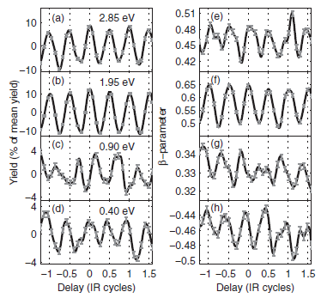
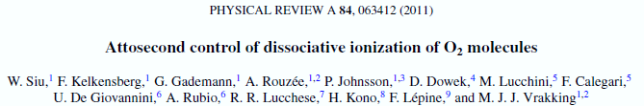
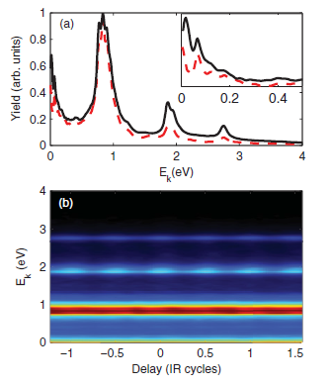
Attosecond Dynamics in the DPI of O₂
Users’ meeting 2017
First (and only) study of attosecond dynamics in DPI:
XUV APT + IR
O₂ O + O⁺
What is the origin of the oscillations in the O⁺ yield?
What about the ion beta parameter?
Are the different phases related to a photoionization delay?
c ⁴Σ_{u}⁻ to L₁
c ⁴Σ_{u}⁻ to L₂
B ²Σ_{g}⁻ to L₁
O₂* 3²Π_{u} to L₃
Notes:
Beyond photoionization delay, there are many open questions that time-resolved MFPADs might answer
Siu et al.
Oscillation of O+ yield
Origin, beta, related to delay?
MFPADS = complete description of photoionization dynamics with FAB10 and CIEL even possible on the real as time scale
Perfectly suited to address those open questions
PLEIADES

Slide 17
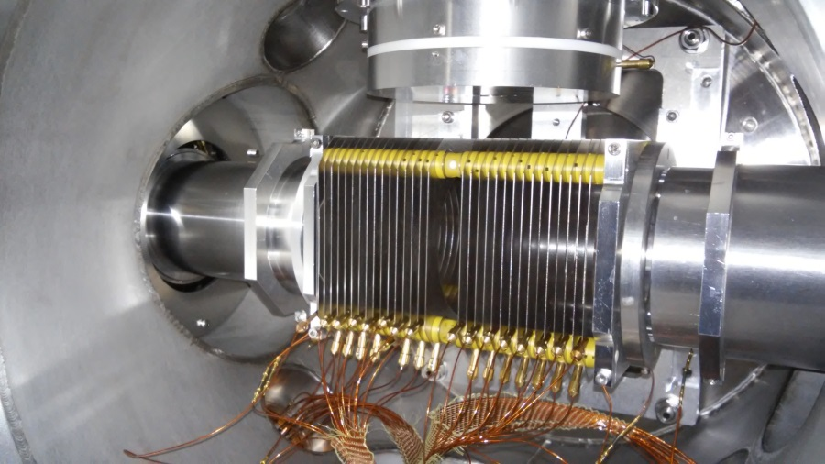


Ready for Real Experiments!

Slide 19
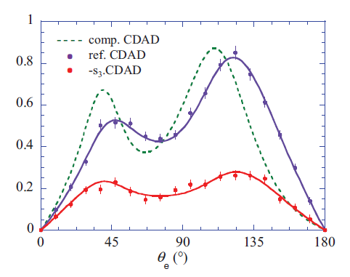
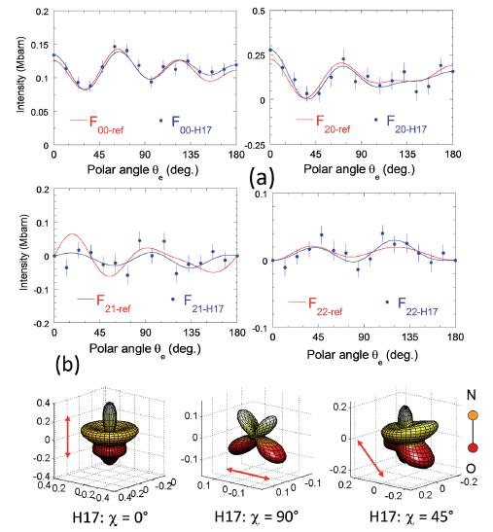


Molecular Polarimetry
Users’ meeting 2017
$I\left(θ_{e},φ_{e},χ,γ\right)$ can be formulated as a function of the Stokes parameters s₁, s₂, s₃^{[6,7]}
s₁,s₂: ion asymmetry parameter β_{i}
s₃: modulates F₁₁ $−s_{3}F_{11}\left(θ_{e}\right)P_{1}^{1}\left(\cos{χ}\right)\sin{φ_{e}}$
Experiments at PLFA in 2015 with HHG
H15
H17
H19
H21
$$χ=90°$$
[6] K. Veyrinas et al., Phys. Rev. A 88, 063411 (2013).
[7] K. Veyrinas et al., Faraday Discuss. 194, 161 (2016).
Notes:
Integration over electron coordinates

Slide 20
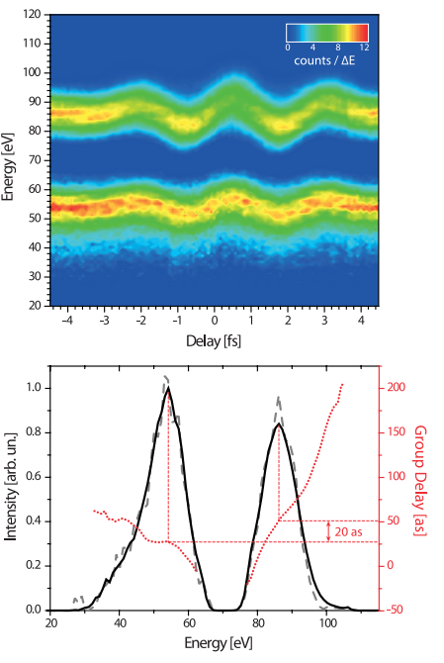
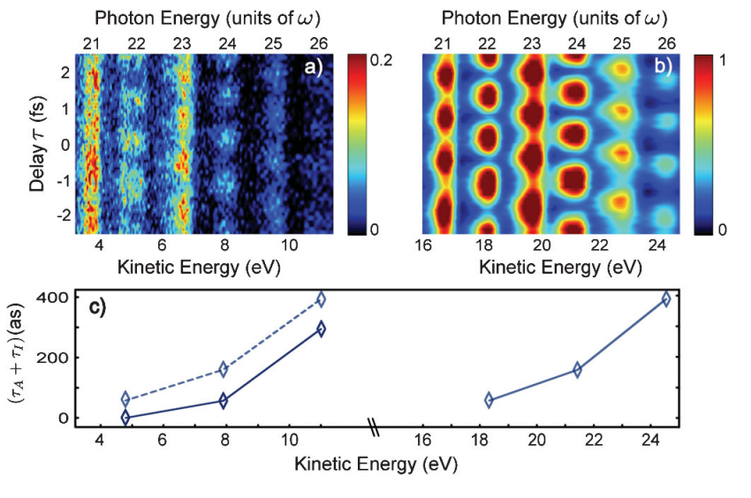
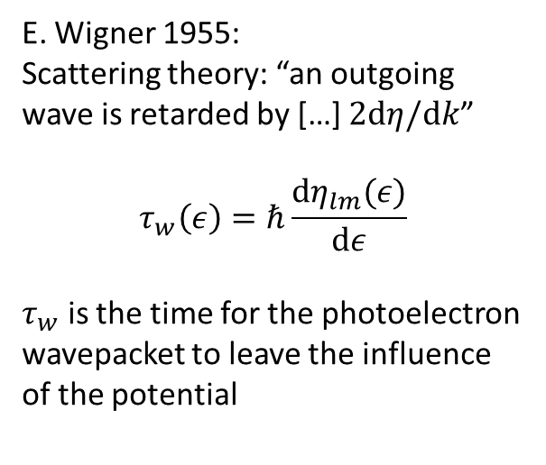
Time Delay in Photoionization
Neon
Argon
E. Wigner 1955:
Scattering theory: “an outgoing wave is retarded by […] $2dη/dk$”
$$τ_{w}\left(ε\right)=ℏ\frac{dη_{lm}(ε)}{dε}$$
$τ_{w}$ is the time for the photoelectron wavepacket to leave the influence of the potential
2p
2s
3p
3p
3s
Klünder et al., Phys. Rev. Lett. 106, 143002 (2011).
M. Schultze et al., Science 328, 1658-1662 (2010).

